Slide 1

Started at 2015 NAATW —
Keeping the Conversation Going 24/7/365

Slide 2
Today’s Presentation:
History of TIAA-forum.org
Demonstration
Status and plans for the future
Questions

Slide 3
History
NAATW:
1st meeting in St. Louis 8/8/2014
grew out of discussions/workshops at Regional Forums and around the fellowship…
Has met annually, generally in person
2 years online (‘19, ‘20)
3 years hybrid (in person and/or virtual)
TIAA-forum:
Came as a result of interest at the ‘14 and ‘15 workshops
Started initially as naatw-forum.org in ~10/2015
First open to members ~3/2016
Now ~3,000 total members (~2-300 active members monthly)
NAATW and TIAA-forum are not the Same
Many people think NAATW and TIAA are the same organization. While there is integration and overlap, they are two different organizations, with different sets of volunteers, structure and, finances.
NAATW and TIAA are Complementary
Both focus on ways of sharing ideas, to leverage technology to support carrying the AA message of recovery
While they are not part of the AA service structure per se, both follow the Traditions and Concepts to the extent possible
NAATW is a once a year conference that usually spans a weekend
TIAA is available every day of the year, seven days a week, twenty four hours a day

Slide 4
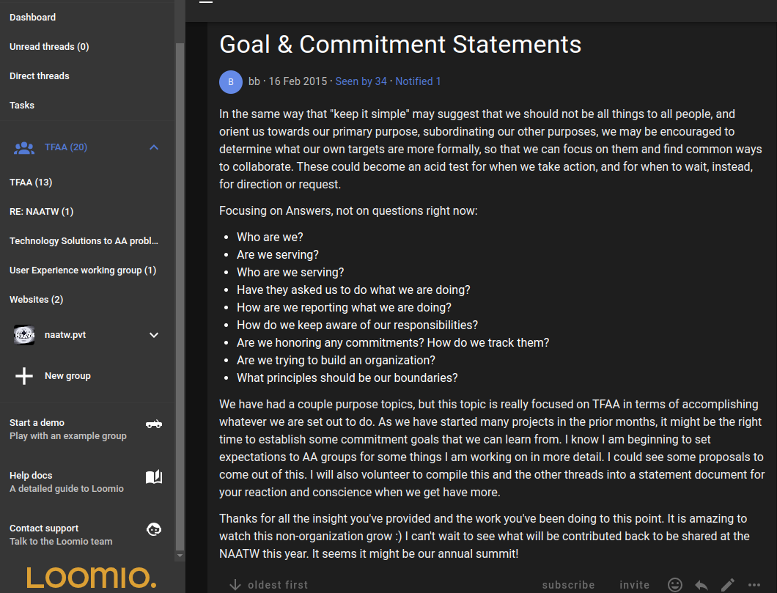
NAATW Goals and Commitments (loomio.com)

Slide 5
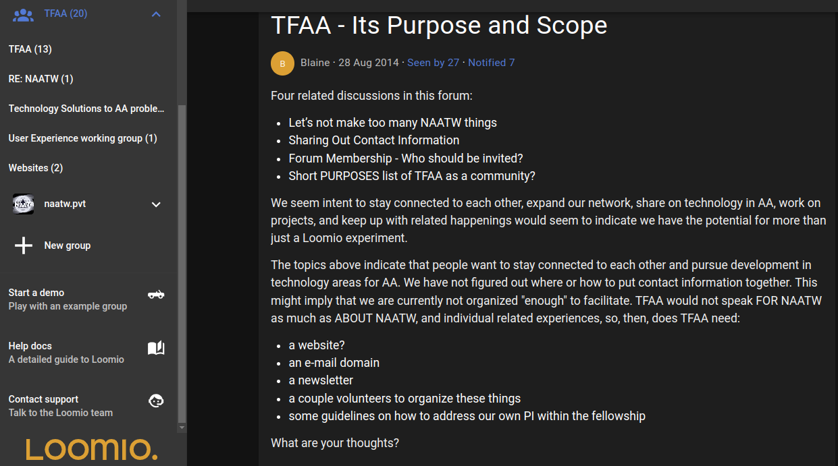
Discussion Begins – TFAA Purpose and Scope…

Slide 6
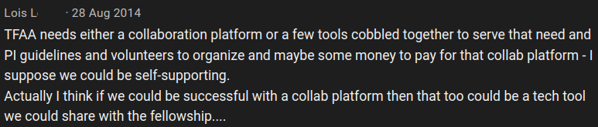
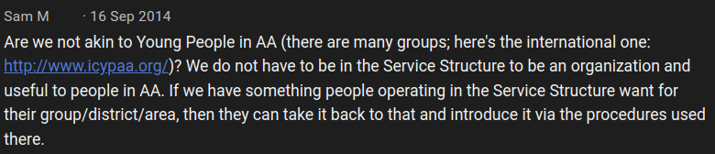
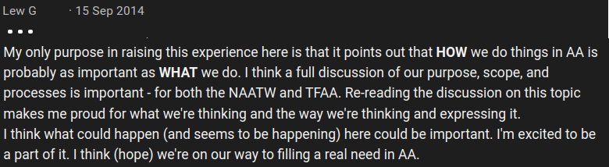
…more discussion on loomio.com …

Slide 7
Technology in AA Online Community (tiaa-forum.org)
Purpose
To share experience, strength, and hope in using technology to carry AA’s message of recovery – not to focus on technology per se.
AA may not be reaching alcoholics we can help
Number of US alcoholics increased 50% in the past 25 years
AA membership remains roughly the same
Can technology help carry the message?
We need non-technical folks to keep the nerds useful!
Whenever literally anyone, literally anywhere, reaches out for help, the hand of AA can be there – virtually, if not physically.
Participation as tiaa-forum.org members by everyone from AA members, web servants, treasurers, tech servants to Area Delegates, Trustees, GSO staff
What is available?
General discussions of how we do what we do in AA service
How do we stop reinventing the wheel?
Many of the needs of Groups, Districts, Intergroups, and Areas are similar
Experiences for meeting those needs can now be shared and stored for future reference
Community currently has over ~3,000 members
Growth has been steady, with a couple of increase “bumps” in ’19 and ’20

Slide 8
Demonstration

Slide 9
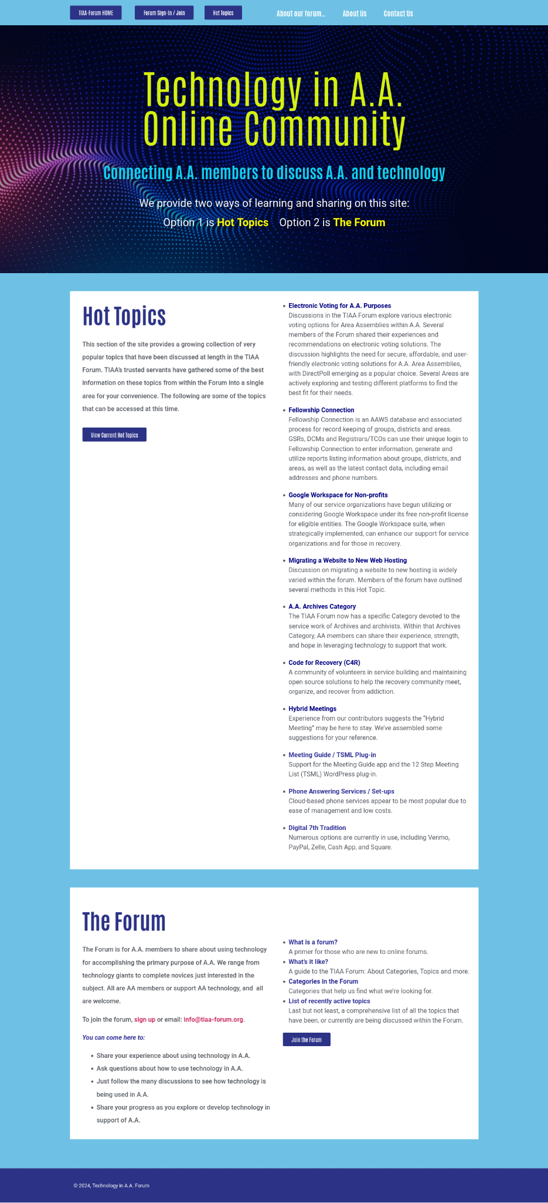
Homepage (public facing)
WordPress “front end”
Displays all the Hot Topics under discussion in the Forum
Allows those who’ve never used the Forum to sample what it offers without logging in
Also allows existing members to see at a glance what is trending
It enables existing members to introduce other A.A. members to the Forum unobtrusively

Slide 10
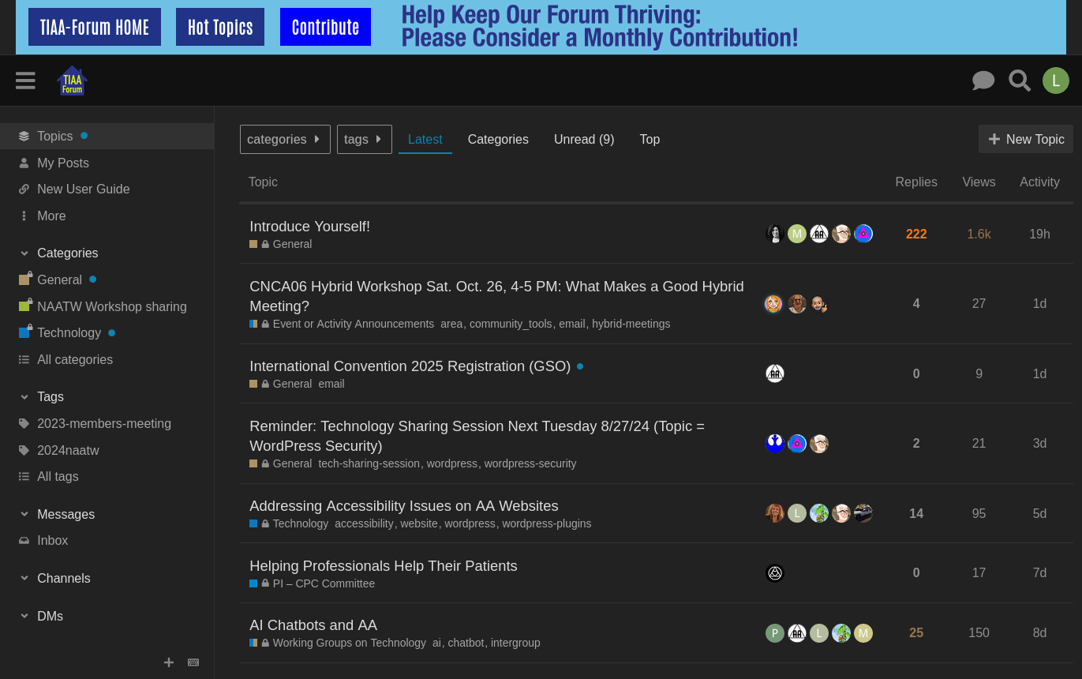
Forum Landing Page
Displays all the Categories in the Forum on a left-hand navigation sidebar
Enables a quick, top to bottom scan of all available categories
Allows a member to select All Categories (bottom of the navigator) if the ‘classic’ view is preferred
Once a specific Category is entered, graphics and other behavior are as previously displayed

Slide 11
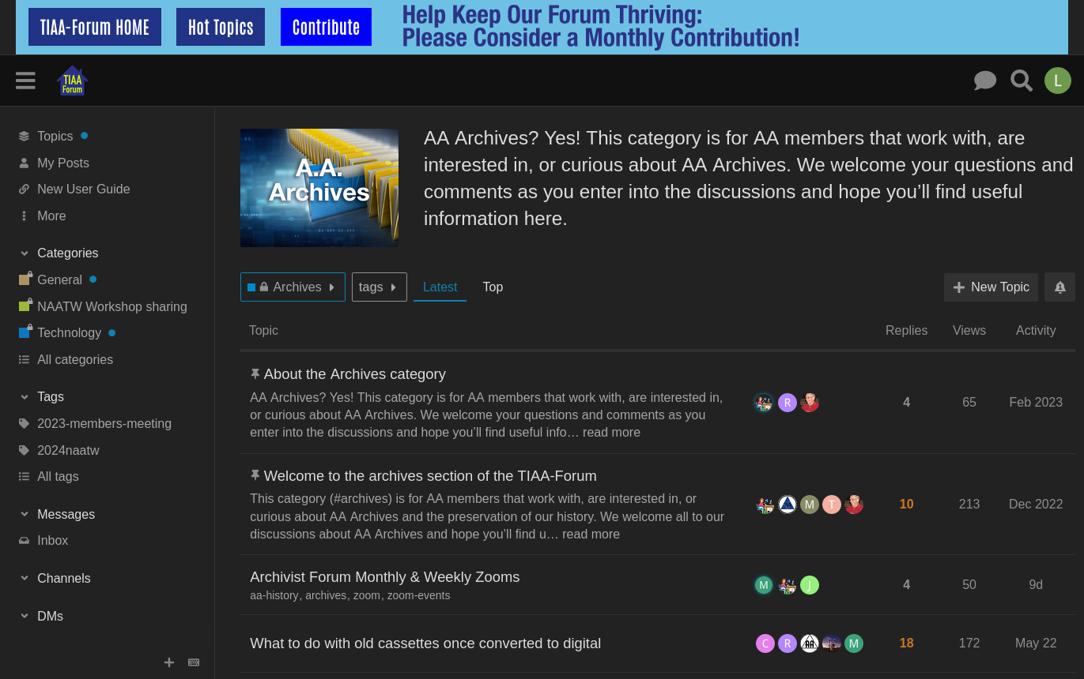
Archives Special Group Landing Page
Area Archives chairs from each of the 93 Areas invited to join the Forum during the 2023 National AA Archives yearly workshop
Enables a central repository in which anyone interested in AA Archives can share their experience, or ask questions of others
Members of the Forum who join the Archives Group as their primary group will land in the Archives Category upon logging in – they can also explore and search the rest of the Forum
Demonstrates the potential for Categories dedicated to the common standing committees at the Area, District and Intergroup/Central Office levels. Public Information/CPC group/category has also been added, and Accessibility is in progress.

Slide 12
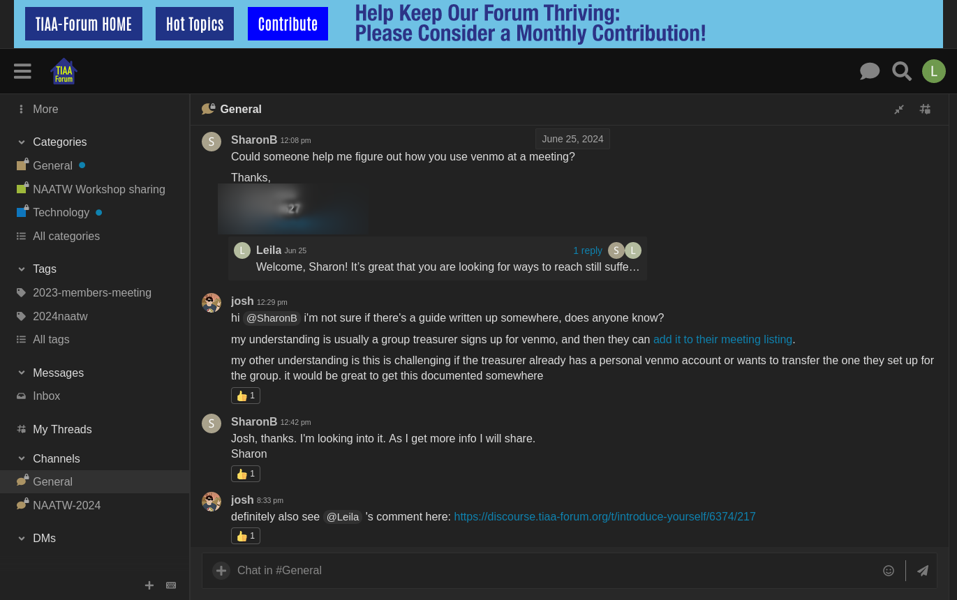
Chat…
Chat feature can be used for temporal back channel communication for Assemblies, meetings, etc
Enables security and anonymity
Similar to Slack, Discord, et al, but without having to join elsewhere or use another tool
General Channel can be used by any forum members for immediate, ad hoc communication
Separate (public or private) Chat channels can be configured upon request

Slide 13
Kinds of discussions on TIAA-forum.org
How do I …
set up a website for… ?
run a hybrid District meeting?
accept online payments for our…?
Here’s my experience…
running a hybrid election assembly
setting up a chat function on our Intergroup website
Help! My _____________ is down, broken, giving me an error I don’t understand!
…website, virtual meeting software, donation page, etc.
Anyone with experience in …
chairing an online/hybrid group conscience?
dealing with conflict between virtual and in-person meeting attendance?
voting for a hybrid assembly?

Slide 14
How TIAA-forum.org Works
Members can post new topics (questions, information to share, etc.), or contribute to existing discussions by posting replies
Member posts (conversations) are grouped under “Categories,” which cover a wide spectrum of AA and its service structure
All content on the forum is searchable
Any AA member or person doing work for an AA service entity can join tiaa-forum.org
The forum was built on “Discourse,” one of the most powerful forum platforms available
WordPress “front end”
Allows for useful exposure of information to the public
Support for forum signup and contributions
SEO

Slide 15
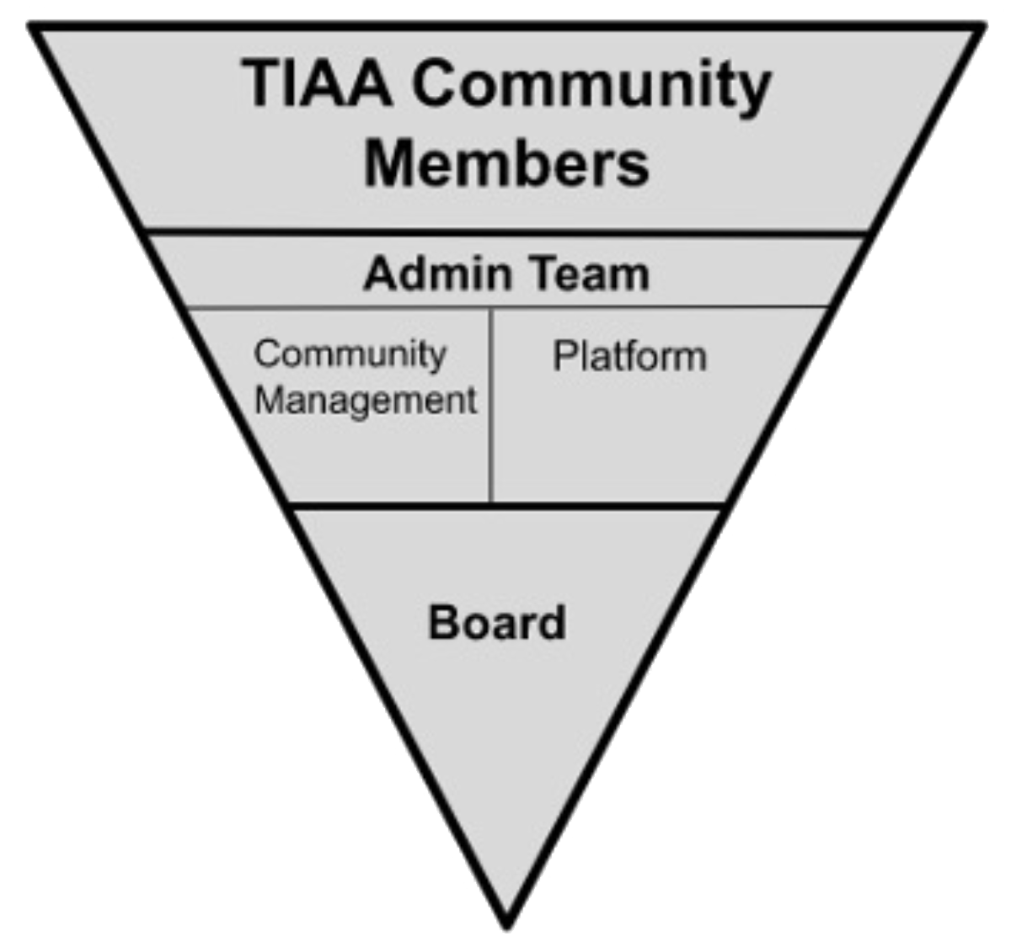
Organization
Community
Poses the questions, share the answers – the heart of TIAA-forum.org
“Private” – comprised of AA members and people who are working with AA service organizations
Admin Team
Responsible for the day-to-day administration of the forum
Meets monthly
Platform Sub-team:
Responsible for infrastructure management
Community Management Sub-team:
Community Support and moderation of Forum following the principle: “...does not wish to engage in any controversy, neither endorses nor opposes any causes…”
keep it simple
policies outlined in our FAQ
Board
Elected by membership to 3 year terms
Officers: President (Chair), Treasurer, Secretary
Meets Quarterly (+members’ meeting and conversations on the forum)
Monitors by-laws, policies, budget, approval of expenditures, etc
Any member can volunteer/stand for any job
Rotation is encouraged
Legally and for tax purposes: TIAA-forum is a 501(c)(3) non-profit organization

Slide 16
Supported Through Our Own Contributions
The forum leverages the same principles of financial governance as the AA program
there are no dues or fees, we are supported by member contributions
all support staff are volunteers, with regular rotation of responsibilities
Our annual budget is developed in consultation with the Admin Team and our Board
presented at our Annual Members' Meeting
approved by the Board
Members can contribute as they wish and can
there is no requirement
the major costs are software and hosting
there is no financial affiliation with GSO, or any other AA entity
For tax purposes, the forum is registered as a 501(c)(3) nonprofit entity

Slide 17
Regular Reviews of Utilization Patterns
Community Management team monthly reviews Utilization trends
Number of sign-ups, posts, pageviews, etc.
Monitors situations in which moderators need to take action
Platform team currently researching use of Matomo analytics
Similar to Google Analytics but all data local to our server
Installed currently on a test system
Evaluating data provided via reports on usage patterns
Ensuring no anonymity concerns/impact on our community
Challenges (for which we need your help!)
Need better data to determine what users want or would like to see in the Forum
Determine why people who might find utility in our forum do not use it
Data collection and evaluation efforts
Done to ensure that we are basing decisions about future direction, features, and budget on solid evidence, not speculation or guesswork
Continuous improvement of outreach efforts based on data about actual usage
Surprisingly little known about tiaa-forum in AA

Slide 18
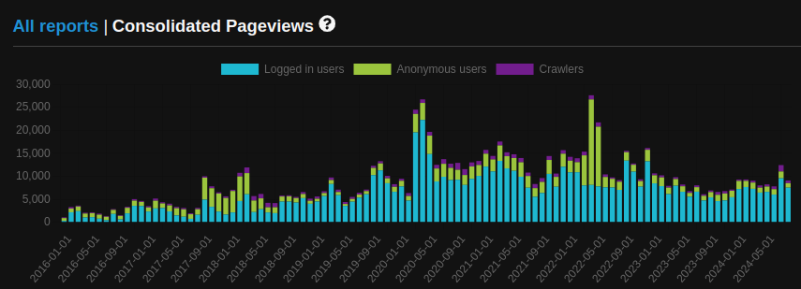
Forum Consolidated Pageviews…

Slide 19
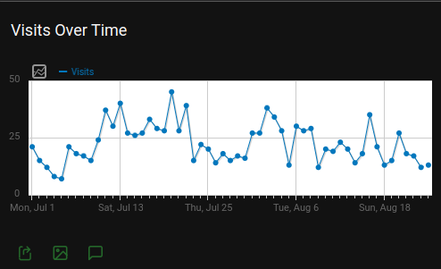
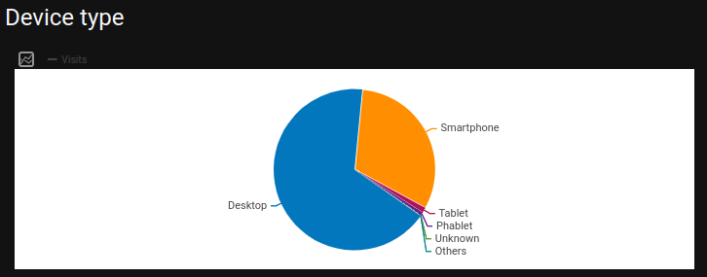
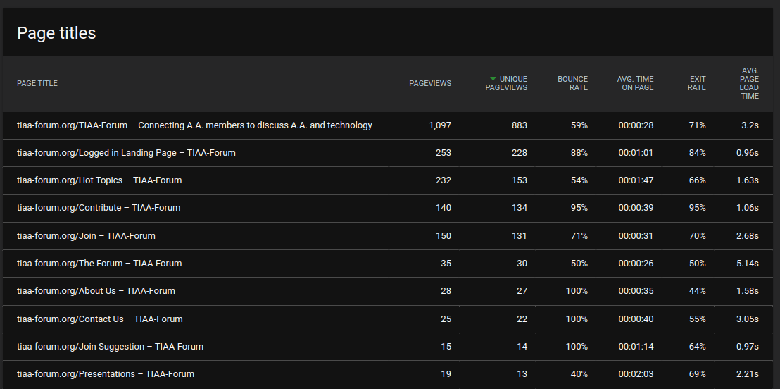
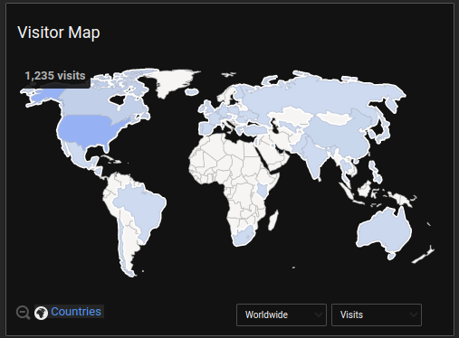
Matomo Testing (WordPress data only…)

Slide 20
What’s New and Upcoming…
Growth
Building on the “interest group” for people supporting AA Archives work
added another group for PI/CPC
working on Accessibility group
Communicate more with people who might find utility in our forum
Intergroups, Districts, Areas, Groups, Workshops, Conventions, etc.
Continuous improvement
Member Guide and documentation revisions
Improved security
Videos, new and improved features, and useful tools for Community Management and members
Continued refresh of our WordPress front end
Generate Hot Topics
using Discourse AI feature
Placing “Hot Topics” outside of our private forum
Information that could be useful to the fellowship about common items of discussion
Improved SEO
Updates to theme/UI
More utility for our community and AA as a whole
New plugin for signups and welcome messages

Slide 21
(shameless?) Plug for Help…
Admin Team - two sub-teams:
Community Management Team
Community development and support
Front-end design / UI experience
Platform team
WordPress experience
Rails/Ember/PHP/Javascript/Docker programming and support experience
Board
4 meetings a year + Members' Meeting is held virtually in December of each year
Online collaboration between meetings
Join!!!
Participate!!!
Contribute
Tell Your Friends
Volunteer

Slide 22
Thank You!!!
Forum Board:
Mike (chair), Cheri, Joel, Lew, Ross, Sam (treasurer), Scott F. (secretary), Shap
Forum Admin Team: Lew (lead), Mike, Shap, Tim Platform Admin Sub-team Tim (lead), Lew Community Management Admin Sub-team Shap (lead), Amy, Brian, Hugh, Leila, Lois, Ross, Scott S, Tim C, Tom C, Viv
But, most of all, we want to thank our wonderful members – all of you!

Slide 23
Questions???

Slide 24
Coming events…
Deep dive into TIAA-forum.org infrastructure
Technology Sharing Session – 24.10.26
Details on the tiaa-forum.org or email info@tiaa-forum.org
Advance member use presentations/tutorials
In progress – stay tuned…

