Slide 1

Solving our common problems —
How technology in A.A. can help
TIAA-forum.org
1 of 17 – 08.15.23

Slide 2
Today’s presentation
What is TIAA-forum.org?
Demonstration
Status and plans for the future
Questions
2 of 17 – 08.15.23
TIAA-forum.org

Slide 3
Primary Purpose of TIAA
To share experience, strength, and hope in using technology to carry AA’s message of recovery – not to focus on technology per se.
The number of alcoholics has grown dramatically over the past quarter century (in the US, by 50%)
AA membership has remained flat at 1.9 million worldwide
There is a growing awareness that today, technology can help carry the message
We need non-technical folks to keep the nerds useful!
Whenever literally anyone, literally anywhere, reaches out for help, the hand of AA can be there – virtually, if not physically.
Participation as tiaa-forum.org members by everyone from AA members to Area Delegates, Trustees, GSO staff
General discussions of how we do what we do in AA service
How do we stop reinventing the wheel?
Many of the needs of Groups, Districts, Intergroups, and Areas are similar; approaches for meeting those needs can now be shared and stored for future reference
Forum currently has over 2,600 members
Growth has been steady, with a couple of increase “bumps” in ’19 and ’20
3 of 17 – 08.15.23
TIAA-forum.org

Slide 4
Demonstration
4 of 17 – 08.15.23
TIAA-forum.org

Slide 5
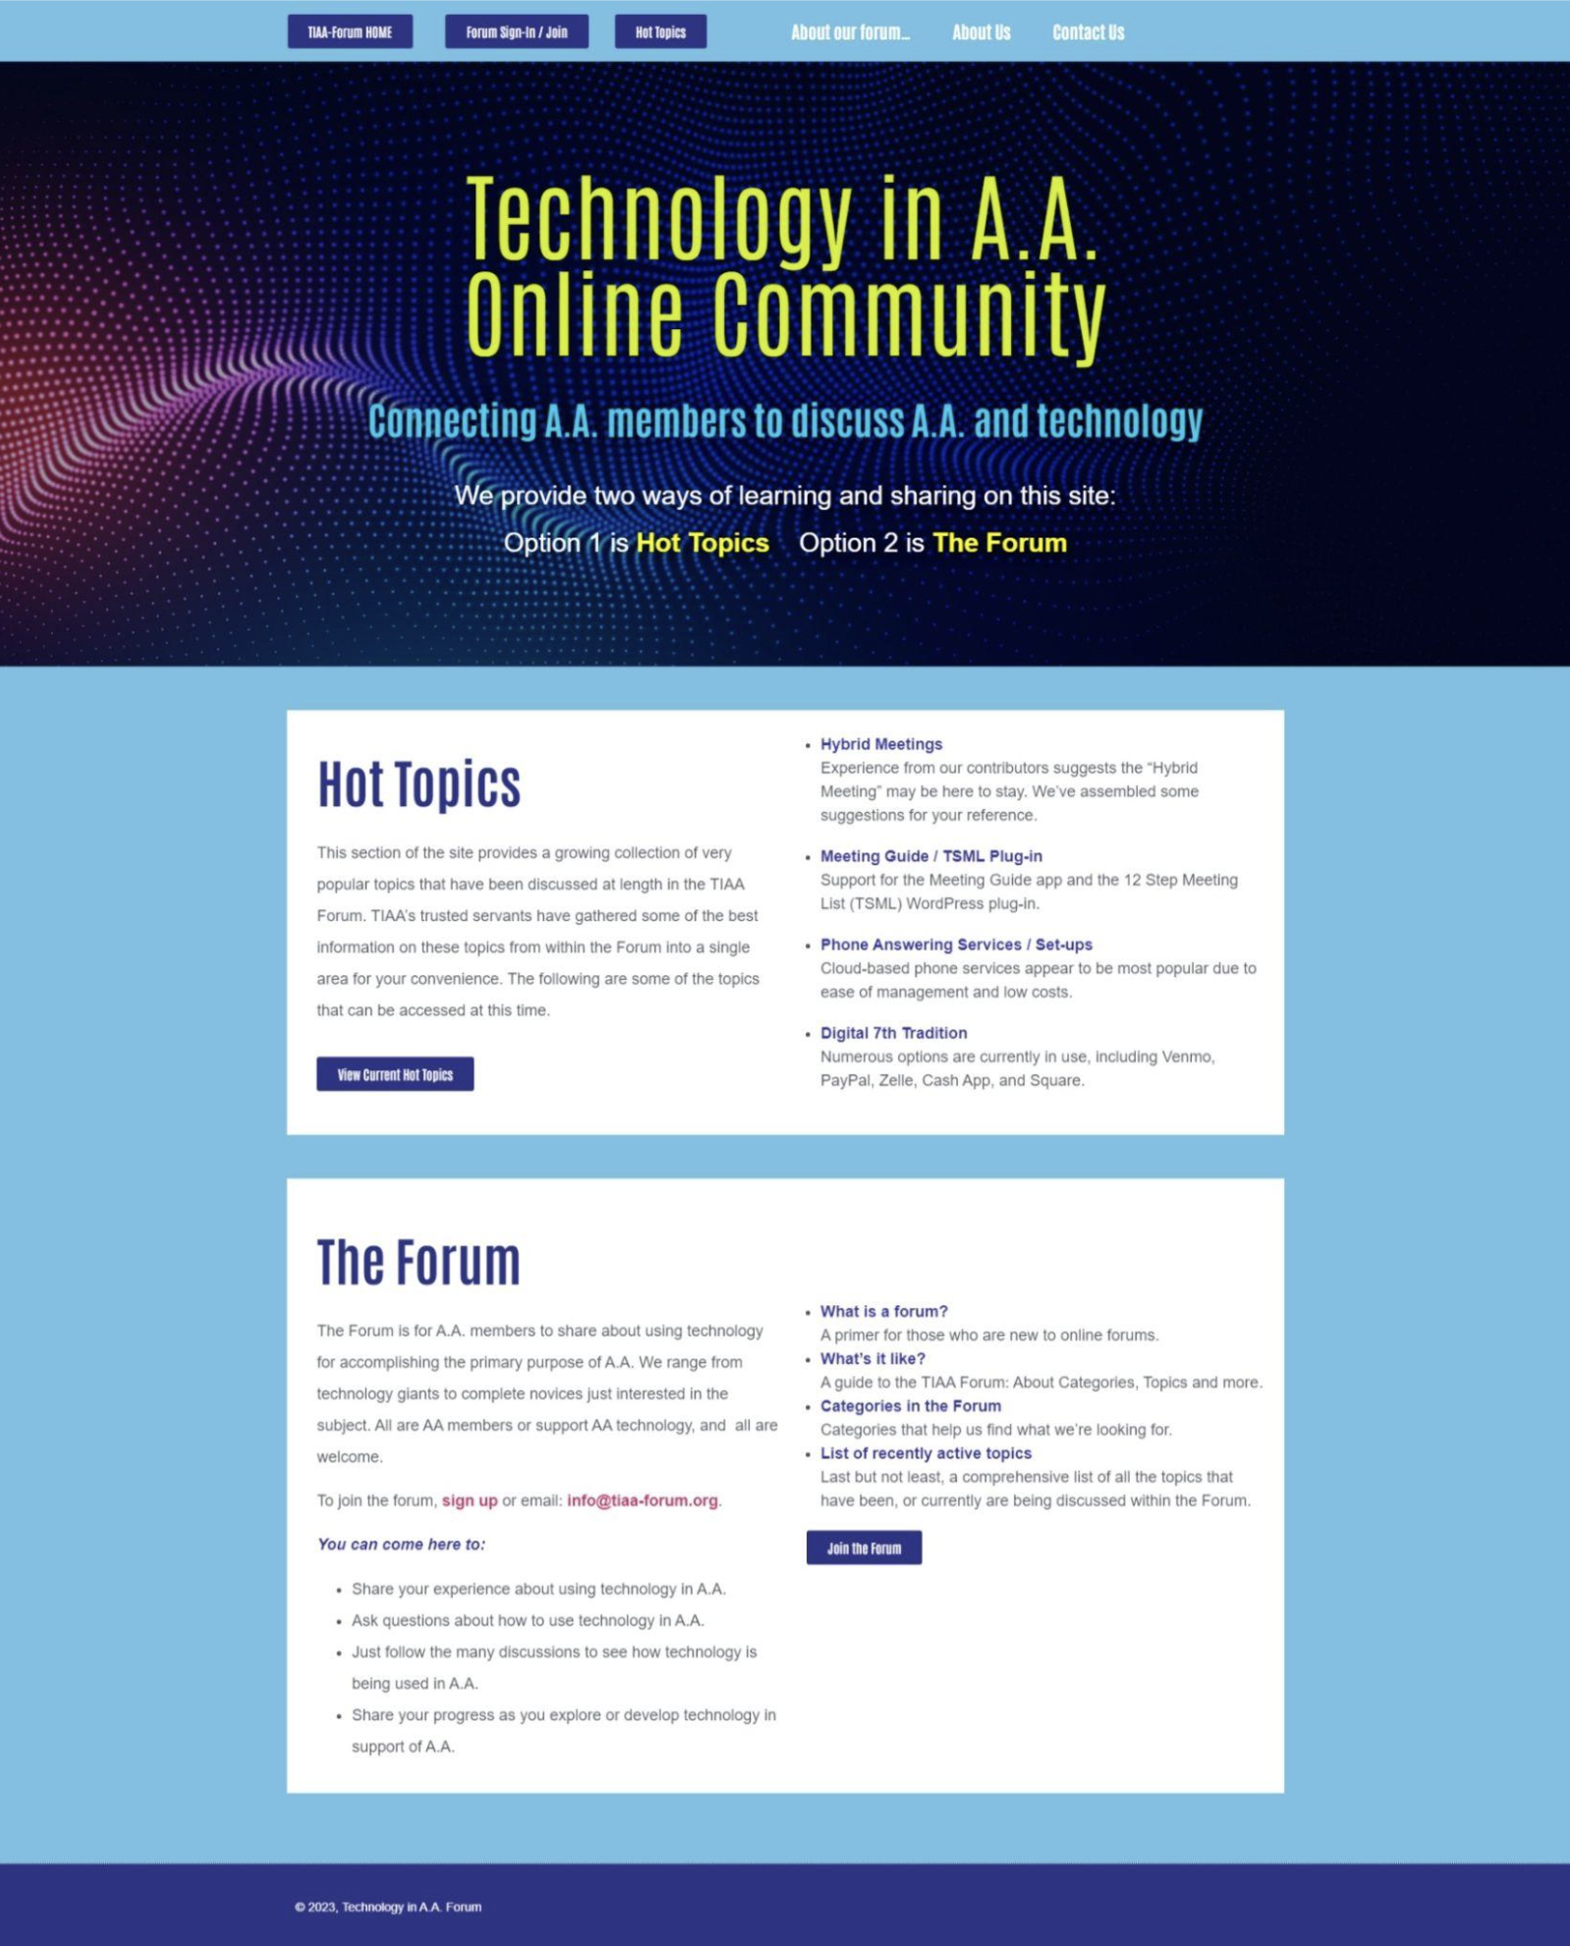
Our homepage was updated in late 2022
It displays all the Hot Topics under discussion in the Forum
Allows those who’ve never used the Forum to explore what it offers
It does not require logging in, as was the case previously
This allows existing members to see at a glance what is trending
It enables existing members to introduce other A.A. members to the Forum unobtrusively
WordPress “front end”
5 of 17 – 08.15.23
TIAA-forum.org

Slide 6
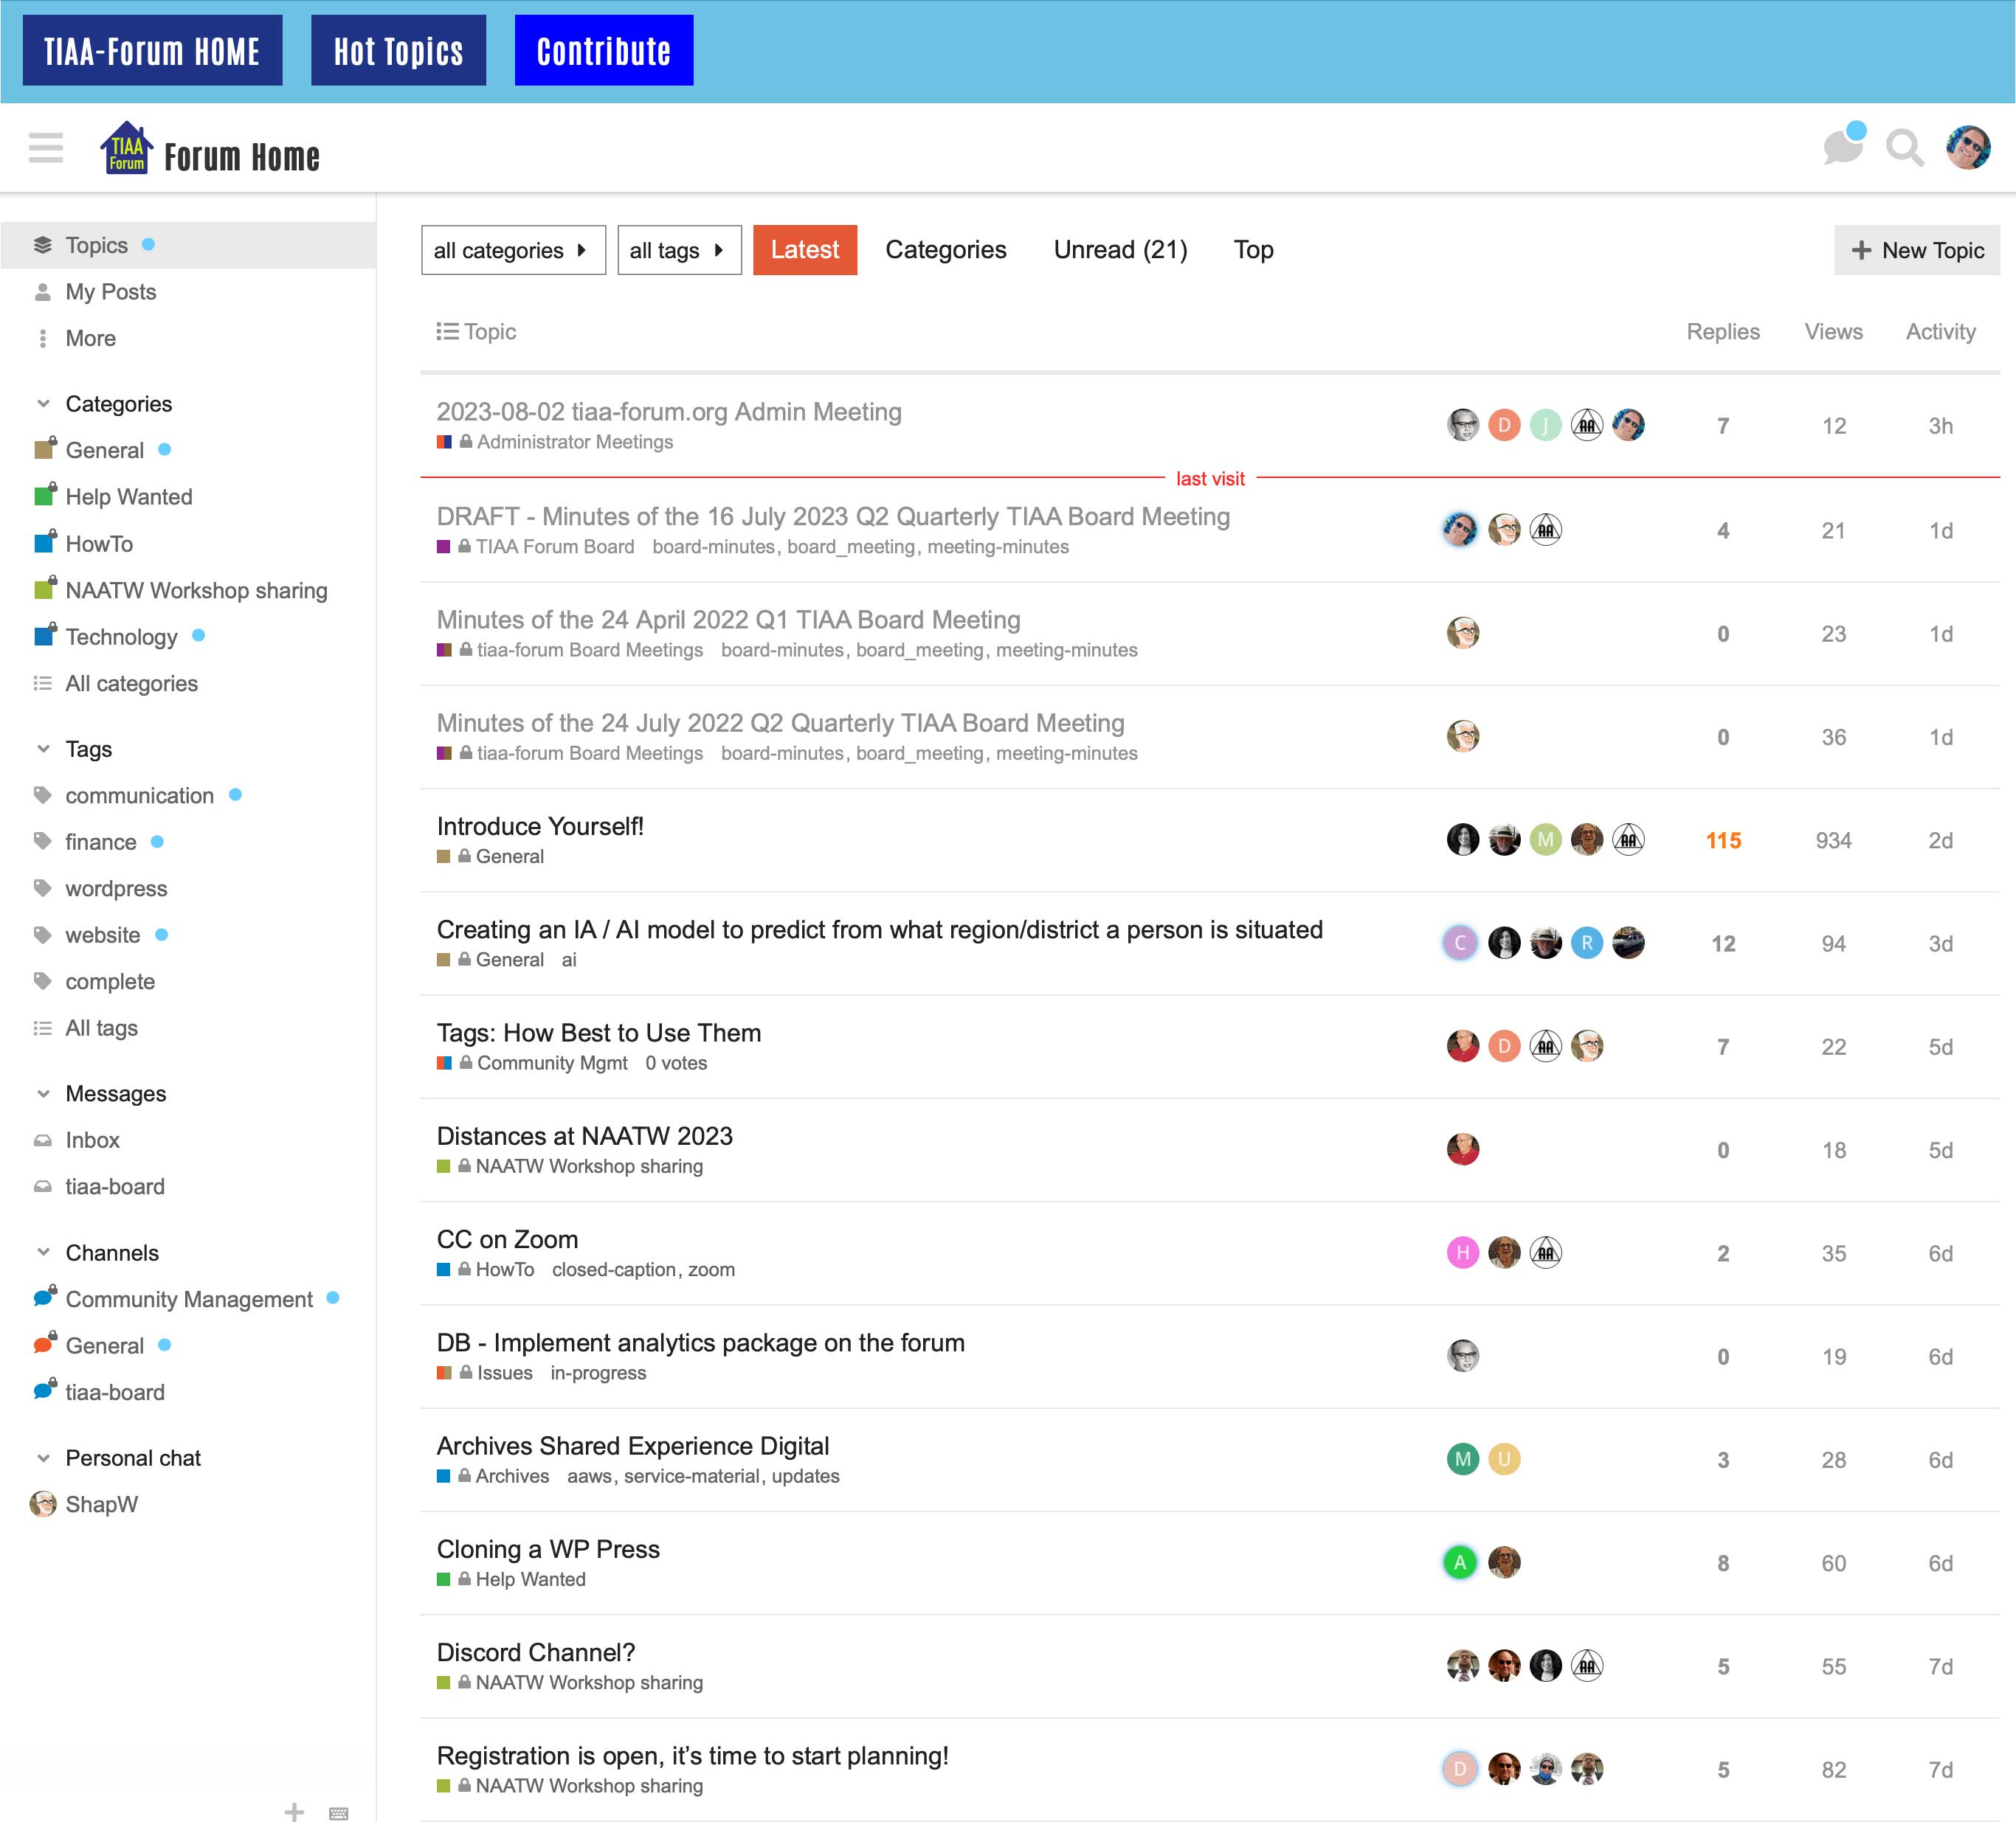
Our new Forum Home landing page was added in 2023
It displays all the Categories in the Forum on a left-hand navigator sidebar
Enables a quick, top to bottom scan of all available categories
Allows a member to select All Categories (bottom of the navigator) if the ‘classic’ view is preferred (as we know, many alcoholics hate change)
Once a specific Category is entered, graphics and other behavior are as previously displayed
6 of 17 – 08.15.23
TIAA-forum.org

Slide 7
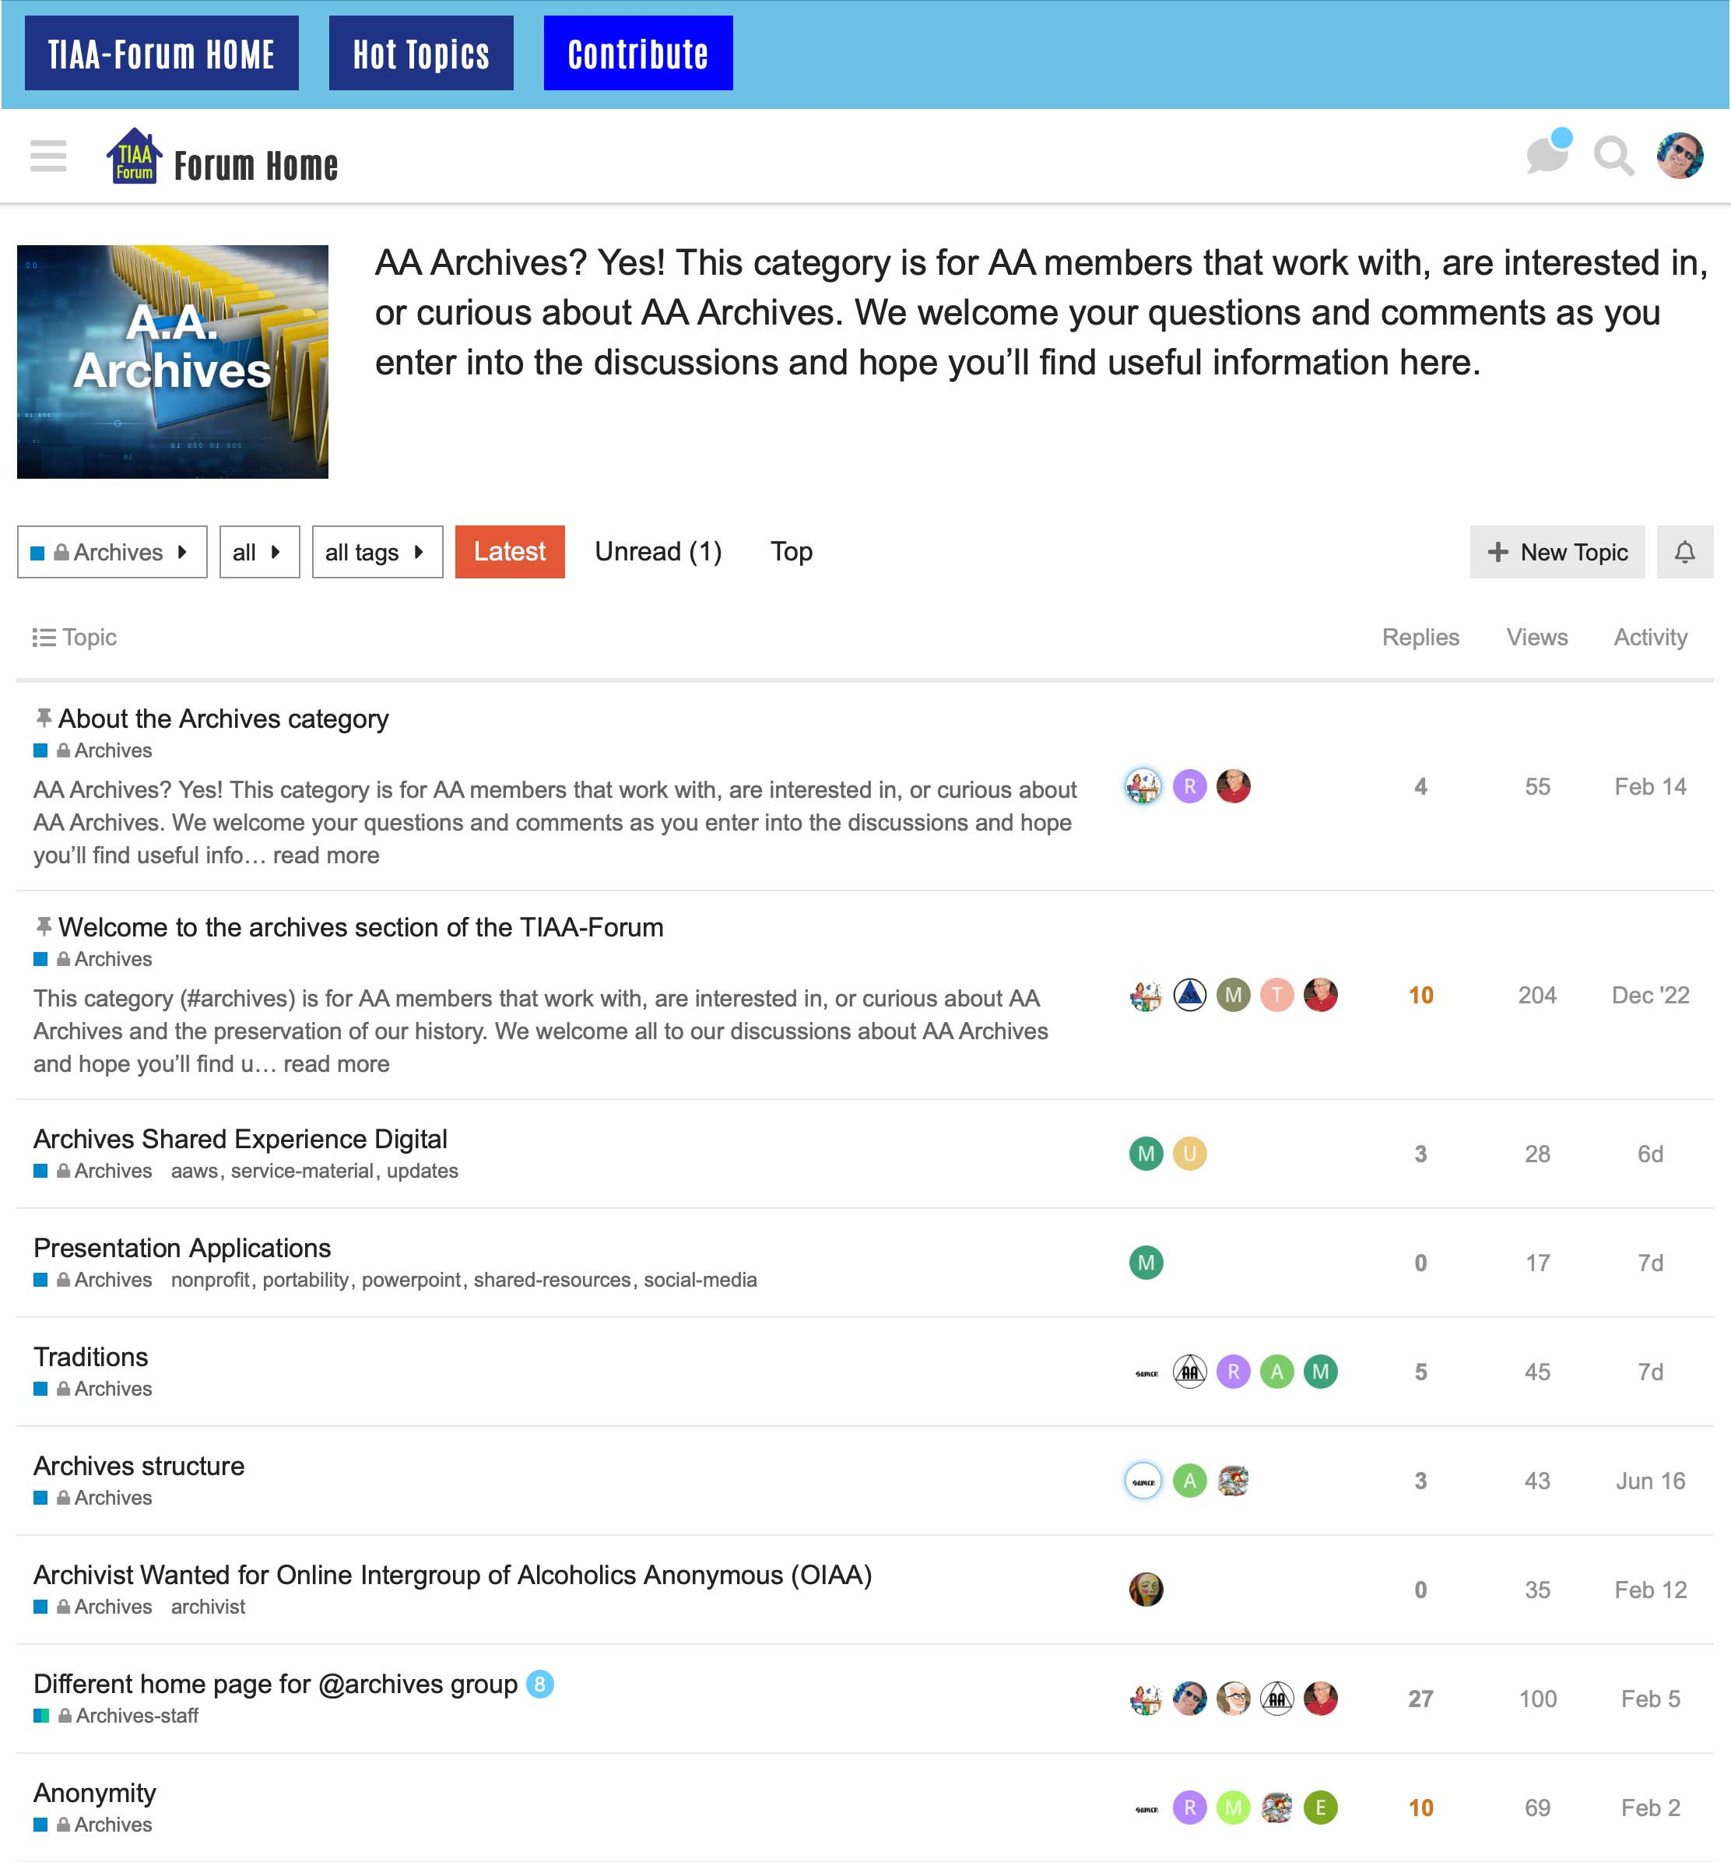
A new Archives category added in 2022
All Archives chairs from each of the 93 Areas invited to join the Forum during the National AA Archives yearly workshop
Enables a central facility in which anyone interested in AA Archives can share their experience, or ask questions of others
Members of the Forum who join the Archives Group will always land in the Archives Category upon logging in, although they are free to explore and search the remainder of the Forum
Demonstrates the potential for Categories dedicated to the common standing committees at the Area, District and Intergroup/Central Office levels(eg, Accessibility, Public Information, Treatment/H&I etc)
7 of 17 – 08.15.23
TIAA-forum.org

Slide 8
Kinds of discussions on TIAA-forum.org
How do I . . . ?
Set up a website for . . .
Run a hybrid District meeting
Here’s my experience
Running a hybrid election assembly
Setting up a chat function on our Intergroup website
Help! My _____________ is down, broken, giving me an error
Websites, virtual meeting software, donation page, etc.
Anyone with experience in . . . ?
Chairing a group conscience
Dealing with conflict between virtual and in-person meeting attendance
8 of 17 – 08.15.23
TIAA-forum.org

Slide 9
How TIAA-forum.org Works
The forum was built on “Discourse,” one of the most popular forum platforms available
Member posts (conversations) are grouped under “Categories,” which cover a wide spectrum of AA and its service structure
All content on the forum is searchable
Members can post new topics (questions, information to share, etc.), or contribute to existing discussions by posting replies
Any AA member or person doing work for AA can join tiaa-forum.org
WordPress “front end”
9 of 17 – 08.15.23
TIAA-forum.org

Slide 10
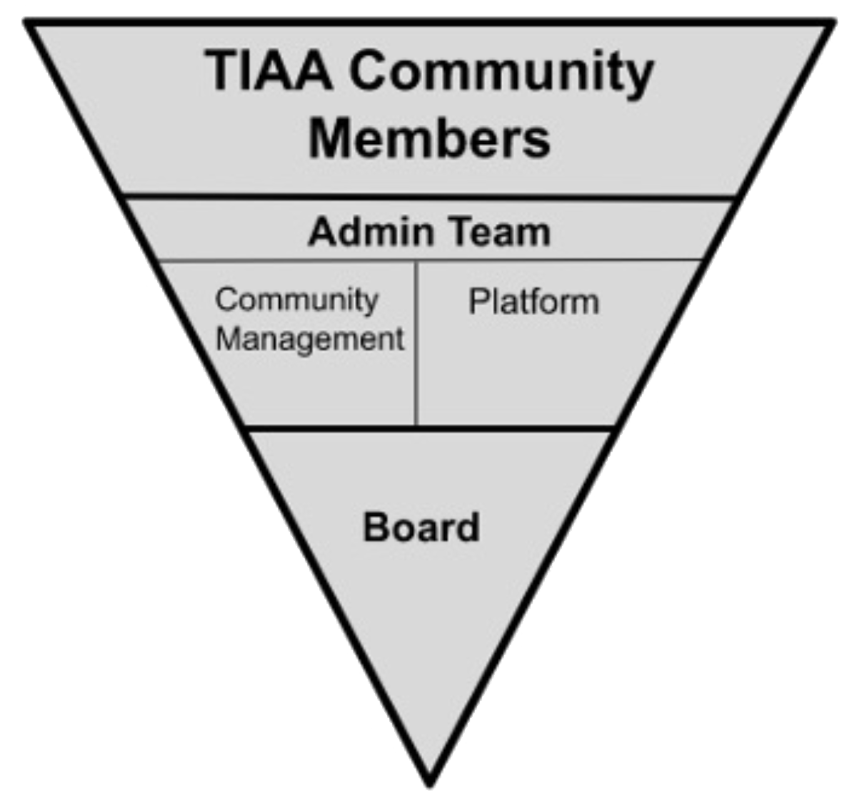
Organization
Community
Poses the questions, share the answers – the heart of TIAA-forum.org
“Private” – comprised of AA members and people who are in service to AA
Admin Team
Responsible for the day-to-day administration of the forum
Meets monthly
Platform Sub-team:
Responsible for infrastructure management
Community Management Sub-team:
Community Support and moderation of Forum following the principle: “...does not wish to engage in any controversy, neither endorses nor opposes any causes…” – keep it simple – policies outlined in our FAQ
Board
Elected by membership to 3 year terms
Officers: President (Chair), Treasurer, Secretary
Meets Quarterly (+members’ meeting and conversations on the forum)
Establishes by-laws, policies, budget, approval of expenditures, etc
Any member can volunteer/stand for any job
Rotation is encouraged
Legally and for tax purposes:
TIAA-forum is a 501(c)(3) non-profit organization
10 of 17 – 08.15.23
TIAA-forum.org

Slide 11
Supported Through Our Own Contributions
The forum leverages the same principles of financial governance as the AA program - there are no dues or fees, but we do have a Contribute button
All support staff are volunteers, with regular rotation of responsibilities
Our annual budget is developed in consultation with the Admin Team and our Board and presented at our Annual Members' Meeting and approved by the Board
Members can contribute as they wish and can, but there is no requirement
The major costs are software and hosting
There is no financial affiliation with GSO, or any other AA entity
For tax purposes, the forum is registered as a 501(c)(3) nonprofit entity.
11 of 17 – 08.15.23
TIAA-forum.org

Slide 12
Regular Reviews of Utilization Patterns
Community Management team monthly reviews (see next slide, graphs)
Utilization trends – number of sign-ups, posts, and pageviews
Monitors situations in which moderators need to take action
Platform team currently researching use of Google Analytics
Installed currently on a test system
Evaluating data provided via reports on usage patterns
Ensuring no anonymity concerns/impact on our community
Challenges (for which we need your help)
Need better data to determine what users want or would like to see in the Forum
Determine why people who might find utility in our forum do not use it
Data Collection and evaluation efforts
Done to ensure that we are basing decisions about future direction, features, and budget on solid evidence, not speculation or guesswork
Continuous improvement of outreach efforts based on data about actual usage
12 of 17 – 08.15.23
TIAA-forum.org

Slide 13
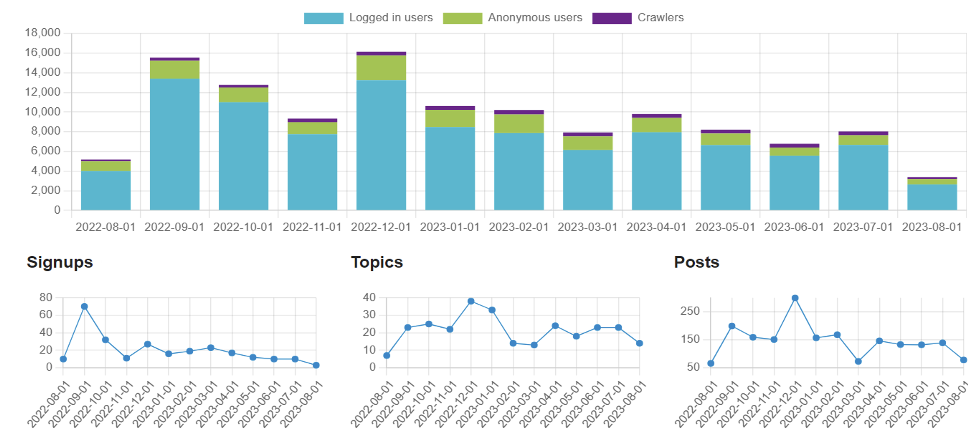
Consolidated Pageviews
13 of 17 – 08.15.23
TIAA-forum.org

Slide 14
What’s new and upcoming?
Moved from self-hosted to Discourse.com managed service on 6/15/22
(Mostly) transparent to our members
Managed service removes administrative vulnerabilities
A refresh on our WordPress front end
A change we’re calling “Forum 2.0”
Place some “hot topics” outside of our private forum
Information that could be useful to the fellowship about common items of discussion
Improved SEO, new theme/look, more utility for our community and beyond
Growth
Adding a new “interest group” for people supporting AA Archives work
Communicate more with people who might find utility in our forum – (Intergroups, Districts, Areas, Groups, Workshops, Conventions, etc.)
Continuous improvement
New Member Guide developed
Improved security
Videos, new and improved features, and tools
14 of 17 – 08.15.23
TIAA-forum.org

Slide 15
(shameless) Plug for help
Admin Team
Community Management Team
Platform team
Front-end design / UI experience
WordPress experience
Rails/Ember/Docker programming and support experience
Community development and support
Board
Members' Meeting is held virtually in December of each year
Join
Participate
Contribute
Tell Your Friends
Volunteer
15 of 17 – 08.15.23
TIAA-forum.org

Slide 16
Thank you!
Forum Board
Mike (chair), Cheri, Joel, Lisa, Ross, Sam (treasurer), Scott (secretary), Shap
Forum Admin Team
Lew (lead), Dave, Mike, Ross, Tim
Admin Platform Sub-team
Tim (lead), Dave, Eric, Lew
Admin Community Management Sub-team
Ross (lead), Jeannie, Mike, Shap, Lois, Viv, Brad
But, most of all, we want to thank our wonderful members – all of you!
16 of 17 – 08.15.23
TIAA-forum.org

Slide 17
Questions?
17 of 17 – 08.15.23
TIAA-forum.org

